Slide 1
The Federation of Texas A&M Mothers’ Clubs
TREASURER BEST PRACTICES
Treasurer Guidelines
Prepare a document of guidelines that your club will follow for any financial transaction (expenses and income) and provide it to your officers.
Include forms that must be completed for any financial transaction (check request/expense authorization/deposit)
Provide a signed “Texas Sales Tax and Use Exemption Certificate” so officers may purchase club items free of sales tax (sales tax should not be reimbursed to an officer)
NEVER PAY AN INVOICE OR PROVIDE A REIMBURSEMENT WITHOUT A COMPLETED FORM AT THE TIME OF THE REQUEST
Budget
Create an annual budget approved by the Executive Board
Any unbudgeted or over budget expenses need to be approved by the Executive Board
Club operating expenses (administrative costs) are to be covered by dues or donations restricted for operating expenses. Monies secured through fundraising activities must not be used for club operating expenses. Operating Funds (dues and restricted donations for operating expenses) may not be used for funding scholarships or other fundraising activities.
Sales Tax
There is a difference between being tax exempt (exempt from paying Sales Tax on purchases) and being exempt from paying Sales Tax to the State Comptroller for items your club sells.
Each club gets 2 tax free days a year (the taxable items you sell on those days are exempt from the sales tax paid to the State Comptroller)
The sale of Raffle Tickets, Memberships, and food items are exempt from the Sales Tax your club owes to the State Comptroller
The sale of tangible items are taxable and total sales amount must be reported to the State Comptroller (State Sales Tax Return) and the corresponding sales tax due must be paid by the club. Filing periods can vary and is determined by the State based on the prior years taxable sales reported.

Slide 2
The Federation of Texas A&M Mothers’ Clubs
TREASURER BEST PRACTICES
Fundraising (RAFFLES)
Clubs can have 2 raffles per calendar year (Jan 1 through Dec 31). They can not be run at the same time.
Raffle tickets may not be sold or offered for sale statewide. Since a website is a finite place on the web, tickets CAN be sold from the club’s website.
Raffle tickets may not be advertised statewide or through paid advertisements. Posting on your club’s website and closed Facebook page are OK and not considered state-wide advertising.
Each raffle ticket must contain: name of organization, address (can be website or email address), ticket price, general description of any prize having value of $10 or more, and date of drawing and how winner will be notified.
No cash prizes can be awarded (gift cards are okay since they can not be converted to cash).
Clubs may have to file IRS paperwork depending on the value of the prize. Club must publicize the value of the prize.
Fundraising (Silent Auctions)
Clubs must collect sales tax (and report to State Comptroller) on tangible Silent Auction items unless the Silent Auction occurs during one of the clubs 2 tax free days.
Item donors may claim a charitable tax deduction (club provided letter).
Treasurer Reports & Responsibilities
Income and Expense Report (Profit & Loss/Balance Sheet) should be provided to the membership at each Board Meeting.
Monthly Financials to officers and/or at any Executive Board Meeting
File Club’s annual 990.
File Club’s Sales Tax Return (monthly, quarterly, or annually as required by State Comptroller depending on sales reported).
File Required Federation Forms (Form T, Form Y, and Form B)
Keep “books” with end of year audit in mind

Slide 3
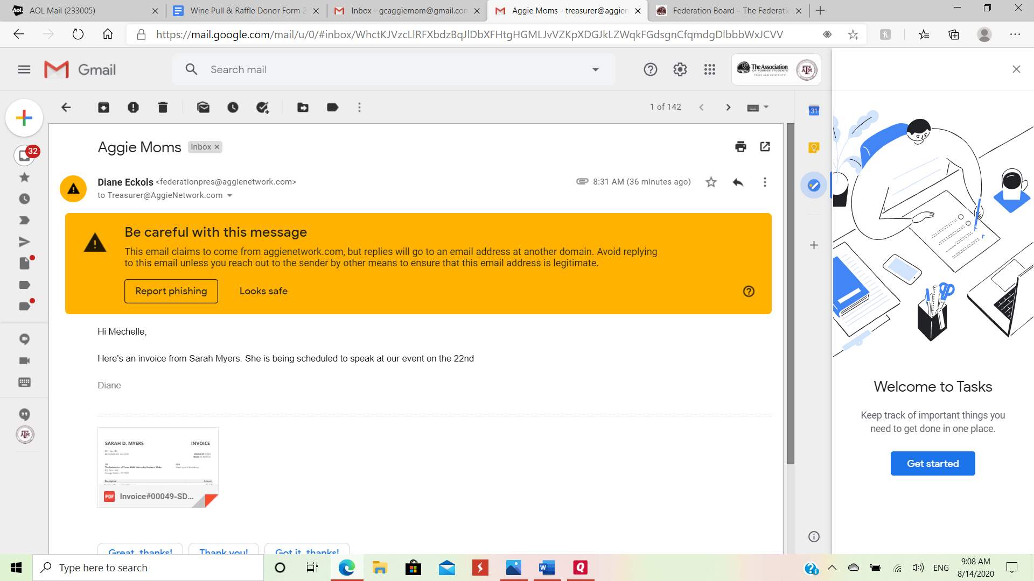
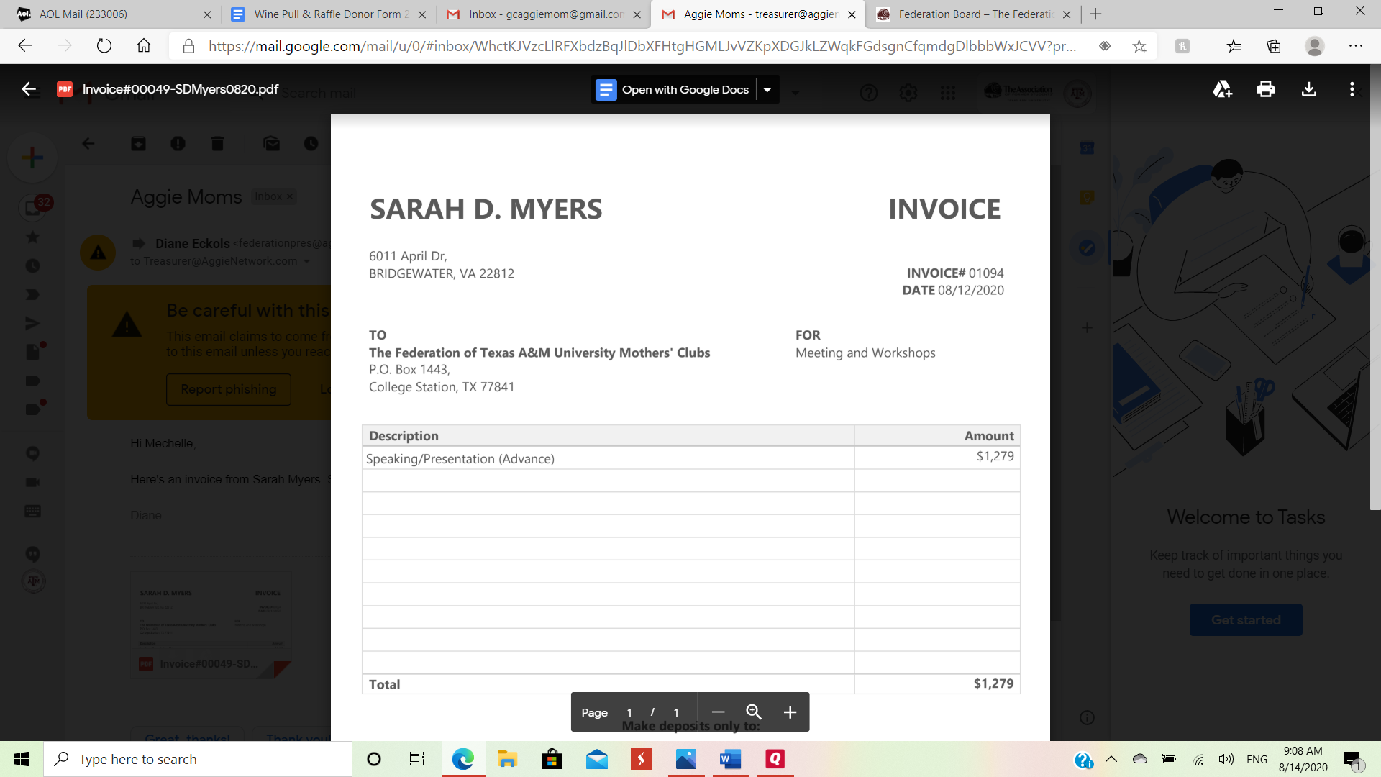
The Federation of Texas A&M Mothers’ Clubs
TREASURER BEST PRACTICES
Phishing Scams (Financial)
These are increasing and becoming smarter
Make sure the “Treasurer Guidelines” you put in place take into consideration the possibility of this happening
Have a meeting with your officers informing them of the phishing issues so they are aware of the possibilities
Having an official form (check request/fund authorization) that must be completed PRIOR to any payment being made is KEY
Using the provided/available @aggienetwork.com email helps utilize google docs and may give extra protection

