Slide 1
Scholarships & Financial Aid

Slide 2
General Information Scholarships & Financial Aid
72% of the student body receive some form of financial aid

Slide 3
Services we Provide
Advising on student aid
Grants
Scholarships
Federal, State, Institutional, & Alternative Loans
Short-term Loans
Student Employment Office
Money Education Center
Veteran Services Office
Texas A&M disbursed $836m in financial aid to assist students
37% receive scholarships 35% receive Loans
31% receive grants 8% tuition waivers
24% earn wages/work

Slide 4
Scholarship Notes
Incoming freshman apply for scholarships along with admission to the University
Fall 2024 deadline is December 1, 2023
Currently enrolled students apply for scholarships through the University Scholarship Application https://uwide.tamu.edu
2024-2025 deadline is February 1, 2024

Slide 5
Some Stats for the Class of 2024
Admissions applications:
49,294 applications
39,714 complete applications
19,735 admits as of 1/8/20
Scholarship applications
29,663 submitted
12,955 complete/admitted (freshman pool)

Slide 6
Financial Aid Consideration
Historically, the FAFSA has been available beginning October 1 each year. For 2024-2025 academic year information, please visit aggie.tamu.edu
Freshman awarding will happen by the end of January
Continuing student awarding will happen in June, after spring grades have been posted
Remember, financial aid is awarded on a first-come, first served basis

Slide 7
Types of Aid
Grants *
EMPLOYMENT
LOANS
Federal Pell Grant
TEXAS Grant
Supplemental Educational Opportunity Grant (SEOG)
Texas Public Education Grant (TPEG)
Jobs for Aggies
On-and off-campus jobs
Flexible hours
Jobsforaggies.tamu.edu
General Listings in the BCS community
Work Study
Employer incentive
NEED-BASED
Direct Stafford Loan (Subsidized)
Perkins Loan
NON NEED-BASED
Direct Stafford Loan (Unsubsidized)
Parent PLUS Loan
Graduate Plus Loans
College Access Loan
Alternative Loans
SCHOLARSHIPS
*Programs subject to availability of funds.

Slide 8
Texas A&M University Mothers' Club Information

Slide 9
Does your club provide scholarships to Aggie students?
Yes Need to submit Form G to the Federation AND [at minimum] donor form to SFA
No Need to submit Form G to the Federation
Are your scholarships SFA selected or Club-selected?
SFA selected
Club selected
Submit completed donor form with payment
It is best to contact SFA to make sure there are no revisions needed for that year’s criteria, award letter etc.
Submit completed donor form with payment
RECOMMENDATION: Retain records for 1 academic year (AY) for students who were not selected and AY+1 for students who were selected

Slide 10
SFA Selected
BENEFITS
Removes Club from ‘blame’ when a parent questions the selection/recipient
Larger applicant pool to consider
Less time-consuming for Club
Auditing/recordkeeping with TAMU-SFA
CONSIDERATIONS
Typically, a larger population of students is considered
Occasionally, Club criteria must be revised based SFA awarding requirements
Awarding and recognition time frames based on when awarding data becomes available and SFA awarding timeline

Slide 11
SFA Selected
Time Frame of Data Availability
FRESHMAN
Data becomes available starting mid-December for the following academic year
If financial need is considered, student must have FAFSA on file at time of awarding
CONTINUING STUDENTS
Data available after February 10 for the following academic year
If financial need is considered, student must have FAFSA on file at time of awarding
TRANSFER STUDENTS
FALL/SUMMER ADMITS: Data available after June 10
SPRING ADMITS: Data available after November 25
If financial need is considered, student must have FAFSA on file at time of awarding

Slide 12
We would like for SFA to select? How do we get started?
STEP ONE: Contact the SFA with details of your current scholarship process (if applicable) and what changes, if any, you would like to put in place. Discuss what population of students (i.e. freshman, continuing undergraduate, transfer, graduate) you are hoping to award. Discuss timeline keeping any recognition ceremonies in mind.
STEP TWO: Draft the selection criteria (Scholarship Criteria Agreement Template on next slide can be used as an example) and finalize based upon Federation regulations, Club desires, and SFA procedures.
STEP THREE: SFA will keep this criteria on file, will award based on this criteria (once payment has been received), and will contact the club once awardees are selected, if requested. Club will need to follow up if any amendments need to be made.
*Preferred that this process be completed by July 1

Slide 13
**A document similar to this should be on file with SFA for Clubs whose scholarships are SFA Selected**

Slide 14
Club Selected
SFA Preference is to have all outside scholarship information and checks submitted to SFA by July 1
Please include completed Scholarship Donor Form
Available at aggie.tamu.edu, Resources – Forms and Media
Donor Form is under “Donors” tab
Recommended records retention:
1 academic year (AY) for applicants were not selected
AY+1 for students who were selected
Be cognizant of Federation regulations related to scholarship awarding
NOTE: SFA does not have criteria on file for clubs whose awarding process is handled internally

Slide 15
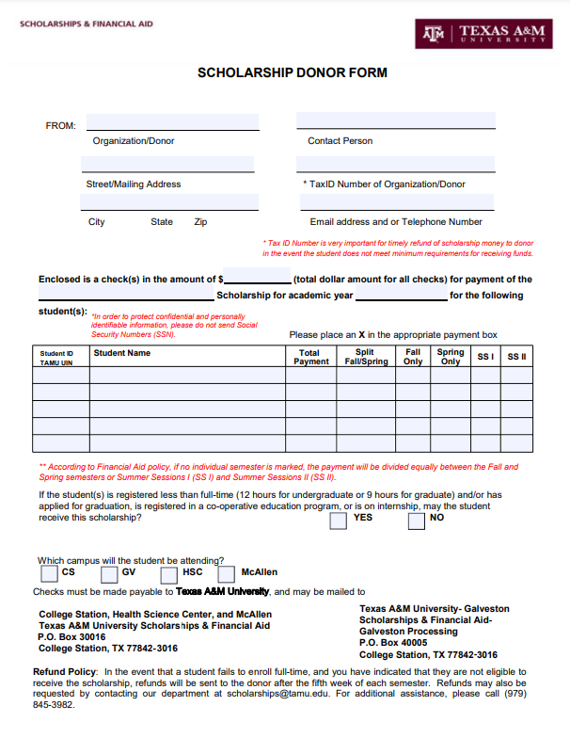
**This document should be sent in with all Club Scholarship checks regardless of whether it is SFA Selected or Club Selected to help us know HOW to disburse the funds.**

Slide 16
SCHOLARSHIPS & FINANCIAL AID
Texas A&M University
P.O. Box 30016
College Station, TX 77842-3016
(979) 845-3236
scholarships@tamu.edu
Aggie One Stop - aggie.tamu.edu
aggieonestop@tamu.edu

