Slide 1
Federation of Texas A&M University Mothers’ Clubs
Fall President’s Luncheon & Training
2024-2025
Presented by:
Roxanne Forrest
President of the Federation of Texas A&M University Mothers’ Clubs
Past President of Medina County Aggie Moms’ Club 2018-2022
And
The 2024-2025 Federation Board Members

Slide 2
Howdy Madame Presidents!
Welcome and Congratulations!

Slide 3
Special thanks to our donor for lunch!

Slide 4
Special Guest
Jason McPhee
Vice President

Slide 5
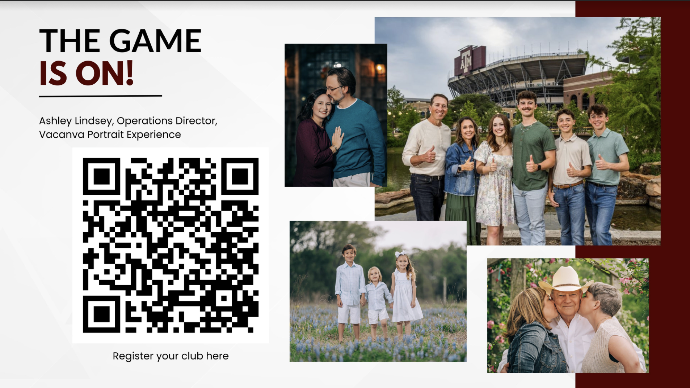

Slide 6
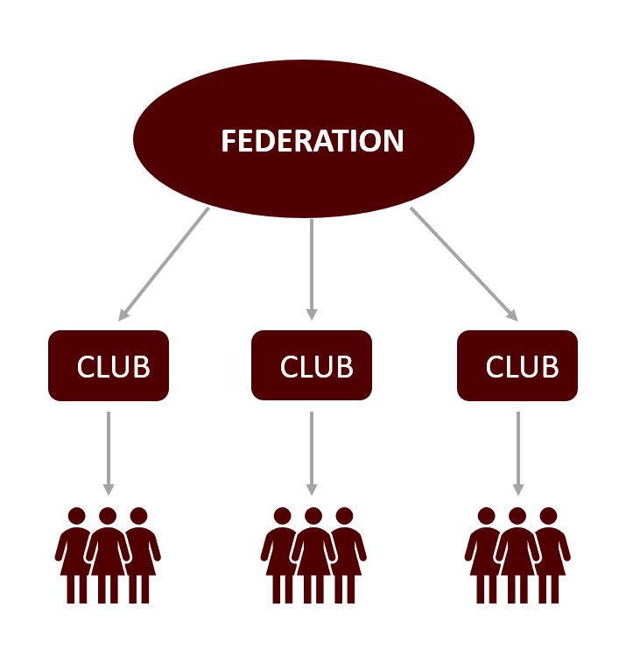
Structure of the Federation

Slide 7
Electronic Information
Updates and information for better communication
Michelle Leggett
electronicinfo@aggiemoms.org

Slide 8
Website Domains
Hosted by Aggie Network
(free to registered clubs)
Emails- try to restrict requests to your core board members only [clubemail]@aggiemoms.org
Phone or email for recovery
Recommended to add a phone or email, however, this has caused an issue for some.
Security

Slide 9
Emails and websites for all clubs - @aggiemoms.org
Transition-If you did not transfer your emails over from Aggie Network Domain, please contact Electronic Information to assist you in doing this.
Every club should use “club” emails, not personal ones, so that the email and all of its contents and drive will transfer to the next officer. When clubs have not turned in Form C’s with officer information at least we can email the “club” email and contact someone

Slide 10
S
hare a file or folder with specific people and set access levels
Select the file you want to share.
Click Share.
Enter the email address or Google group you want to share with.
To decide what role people will have on your file, select Viewer, Commenter, or Editor.
If your account is eligible, you can add an expiration date for access.
Choose to notify people.
If you want to notify people that you shared an item with them, check the box next to Notify people. If you notify people, each email address you enter will be included in the email.
If you don't want to notify people, uncheck the box.
Click Send or Share.

Slide 12
You can share to anyone’s email, or gmail account. Just set the correct permissions.

Slide 13
Aggie Moms App
Please check your club in the app
Any issues/ corrections, please email electronicinfo@aggiemoms.org with corrections

Slide 14
Building Your Membership & Getting Organized
Website
Calendar of Events
Host an Aggie Mom 101 event
Howdy Party
How to invite Moms in the area – request your EIS
Social Media, Word of Mouth, etc.
Pair Experienced Moms and Fish Moms
Constant Contact – be sure to forward to members
Caution – anyone can unsubscribe so put a warning message or copy and paste.
Bylaws – be sure you are following

Slide 15
Make Meetings FUN!
Door prizes, Aggie Swag – use your CC Creations Gift Card
Food, Games
Speakers - https://www.aggienetwork.com/speakersbureau/find/
Social Events
Get to know you “ice breakers”
Talk about your Aggies - majors, class year, dorms, Greek life, on campus/off, Corps of Cadets, etc.
Review Annual Club Reports - A ton of great ideas!
https://aggiemoms.org/wp-content/uploads/2023/08/2022-2023-Compiled-Annual-Club-Reports-Form-D.pdf

Slide 16
Resources
aggiemoms.org – electronicinfo@aggiemoms.org
Social Media -socialmedia@aggiemoms.org
Constant Contact – chiefofstaff@aggiemoms.org
Please share with your club – specify do not unsubscribe
App – Aggie Moms of TAMU
Federation Liaison – can be a lot of help
Aggie Mom University – On website

Slide 17
Aggie Mom Brags
Over $8.8 million has been returned to the University in the form of Scholarships and Support of Student Organizations in the last 19 years!
In the year 22-23
$863,010 in Scholarships
$107,813 in Student Organizations
113 Clubs
7,100+ Members

Slide 18
Importance of Forms & Reports
Familiarize yourself with the Forms and Due Dates to remain in “Good Standing” with the Federation, we all have deadlines and responsibilities.
Aggie Mom University has videos regarding Forms
Link to Forms page on website https://aggiemoms.org/forms/
990’s – due October 15th
Minutes
Bylaws-Sent to Federation Parliamentarian when updated
Dues and Archives - Our record of members (Form B)
Bookkeeping
Audits

Slide 19
Aggie Moms’ Boutique
Is your Club compliant with your Aggie swag?
Questions - Whitney Isbell, 5th VP Boutique
5thvpboutique@aggiemoms.org
TAMU Marketing Resources
https://marcom.tamu.edu/resources/
Licensing and Trademarks

Slide 20
Want to get more involved with the Federation?
Sign up to be an Aggie Mom Ambassador
https://aggiemoms.org/aggie-mom-ambassadors/
Questions - Lezlie Wiederhold, 1st VP Membership
1stVPMembership@aggiemoms.org

Slide 21
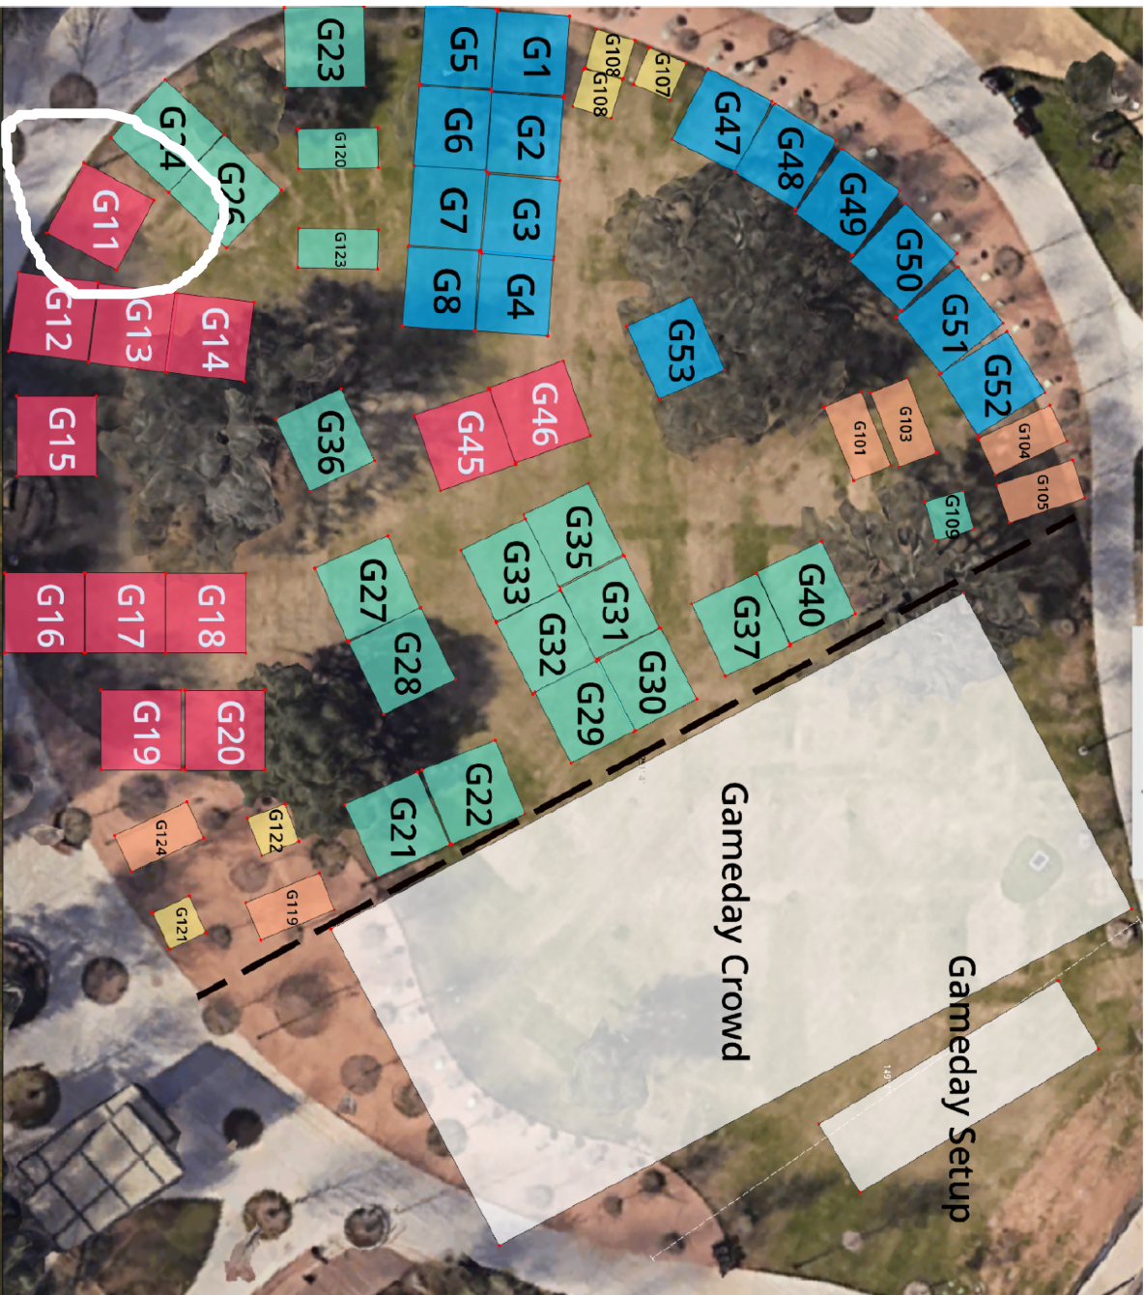
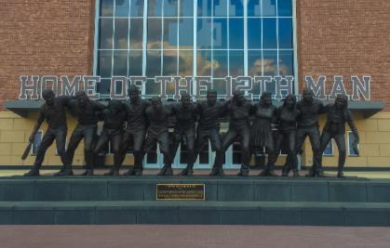
Aggie Moms Tailgates
Dawn Looney – Parent Socials Tailgates
tailgates@aggiemoms.org
Looking for Ambassador’s to help
Aggie Park – Space G11

Slide 22
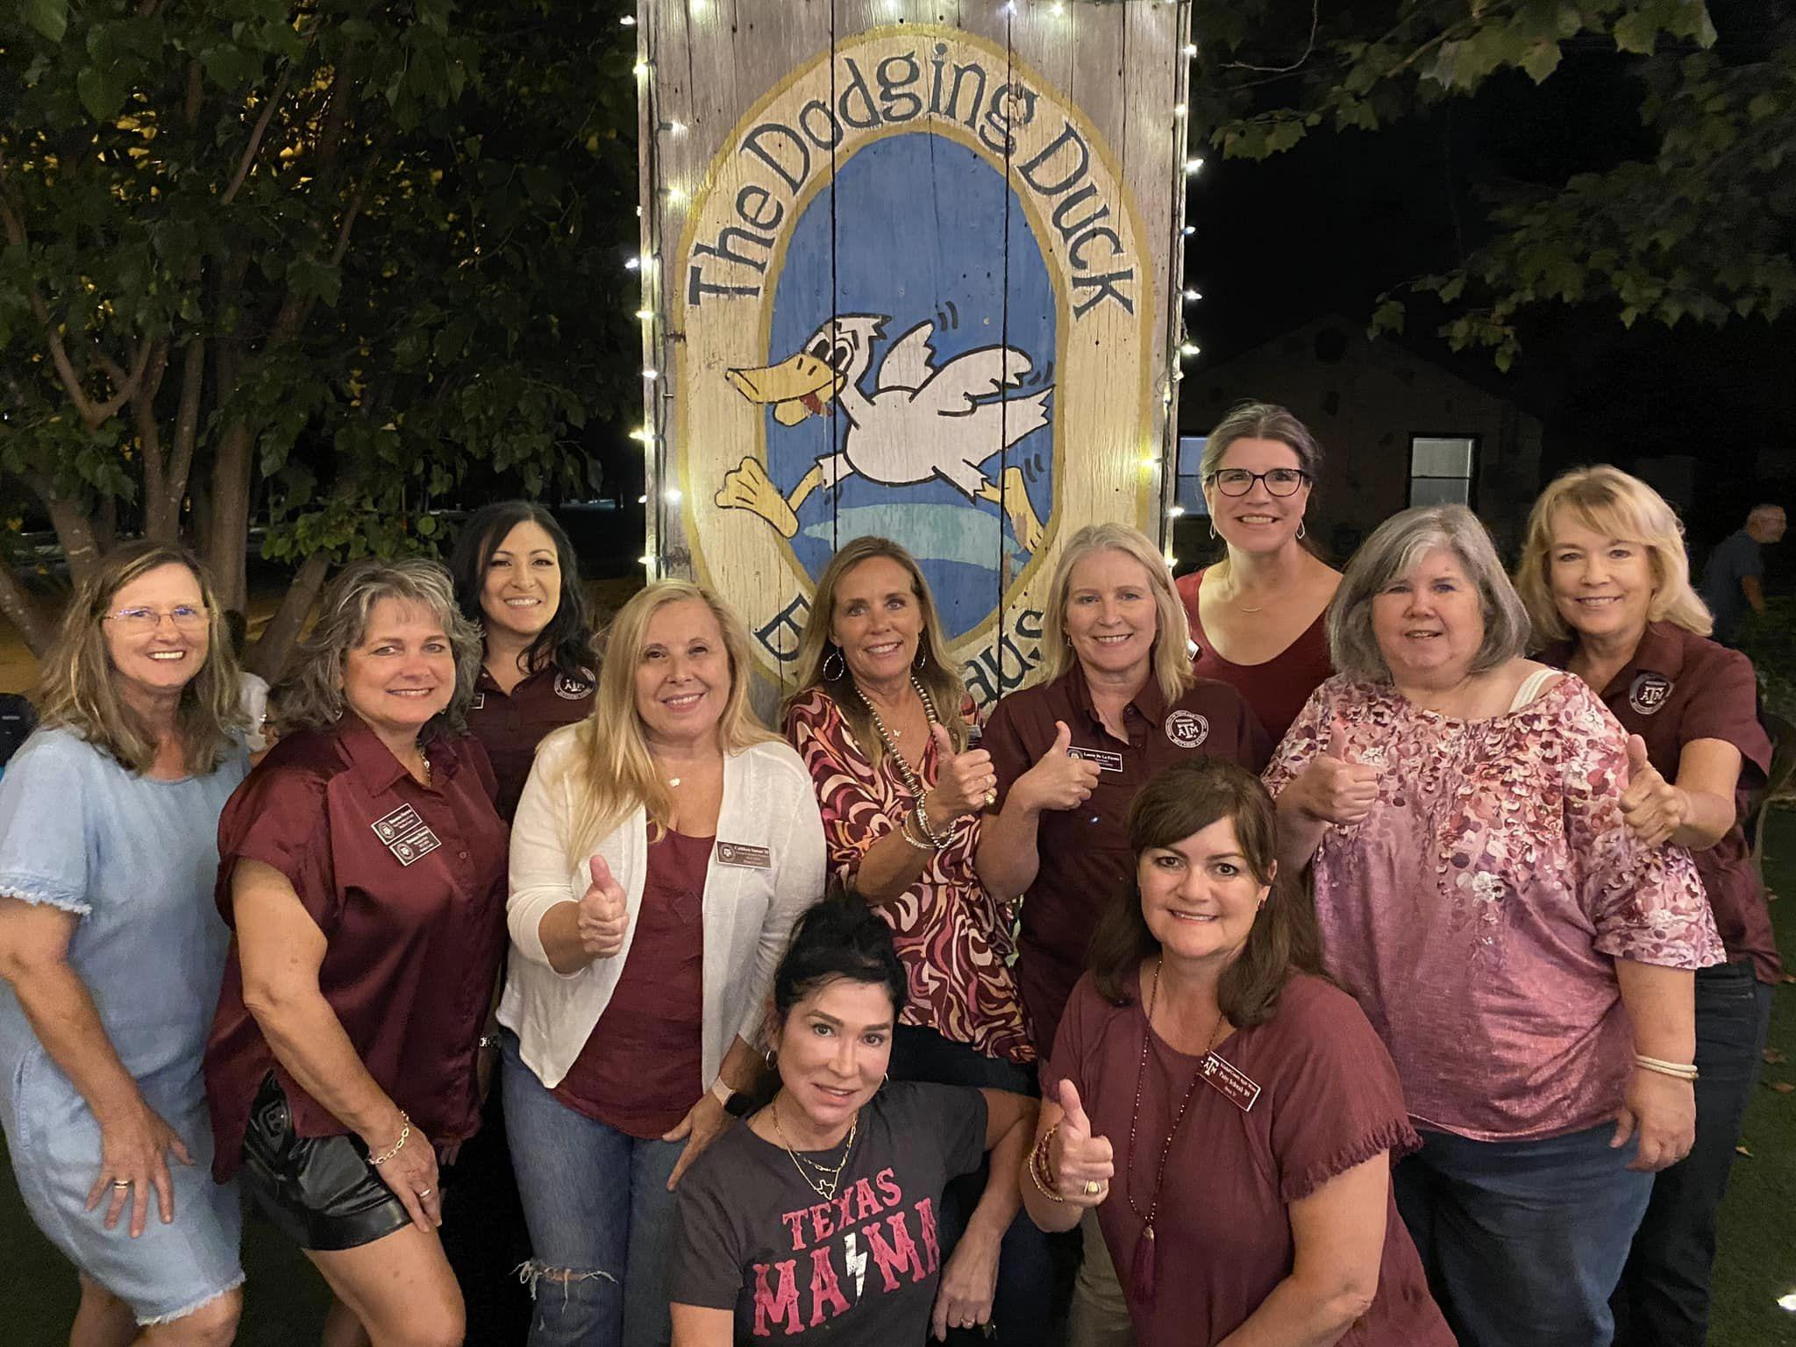
District Meetings
Linda Rodriguez
6th VP Districts
6thvpdistricts@aggiemoms.org
Meeting schedule is on the website.

Slide 23
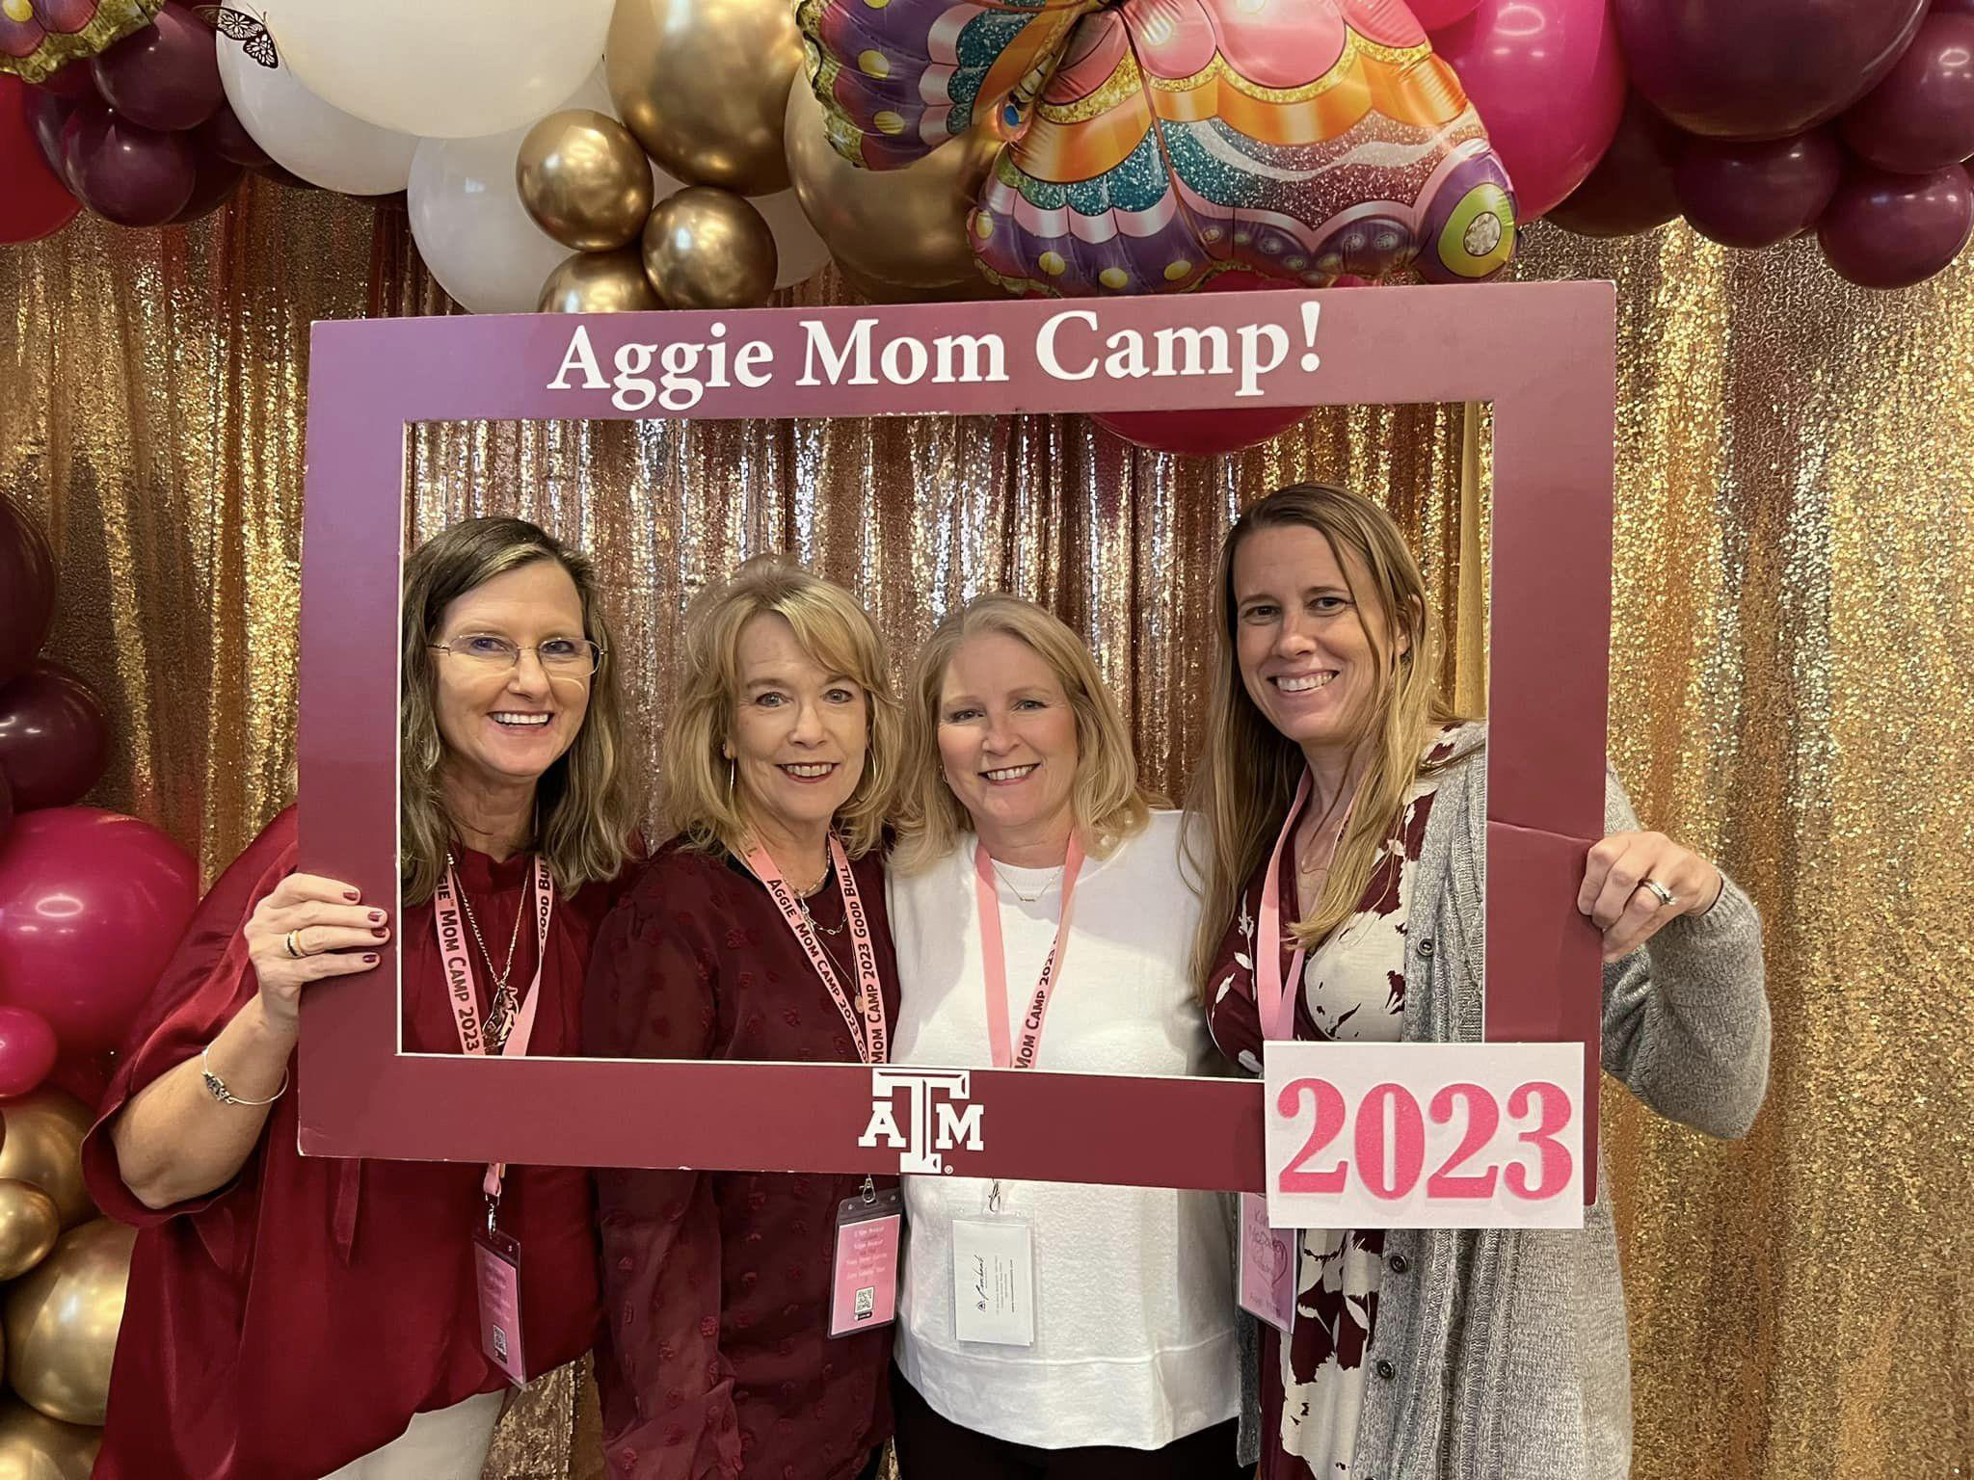
Aggie Mom Camp 2025
February 21 - 23, 2025
Stacy Taylor - Aggie Mom Camp Officer
aggiemomcamp@aggiemoms.org
Karyn Friesen - Counselor Chair
campcounselors@aggiemoms.org

Slide 24
Club Concerns
Nancy Skokan - President Elect & Club concerns
ClubConcerns@aggiemoms.org

Slide 25
Aggie Moms Care
Karyn Friesen
AggieMomsCare@aggiemoms.org

Slide 26
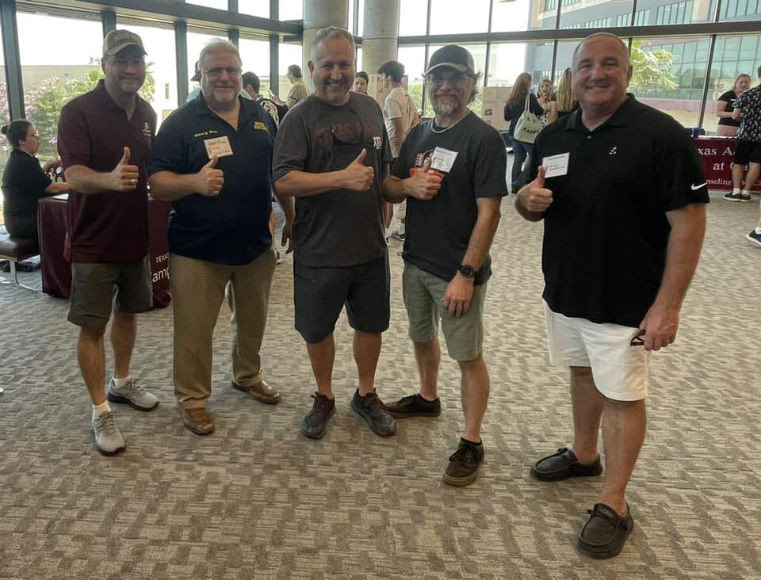
Just Aggie Dads
Nancy Skokan - Committee Chair
AggieDads@aggiemoms.org
Facebook Page - Just Aggie Dads

Slide 27
Hola! En-Espanol
Need anything translated for our Spanish Speaking Aggie Moms?
https://aggiemoms.org?en-espanol/

Slide 28
Ring of Honor Moms
Once an Aggie Mom, Always an Aggie Mom
Kim Kovar
Parent Socials Ring of Honor
RingofHonor@aggiemoms.org

Slide 29
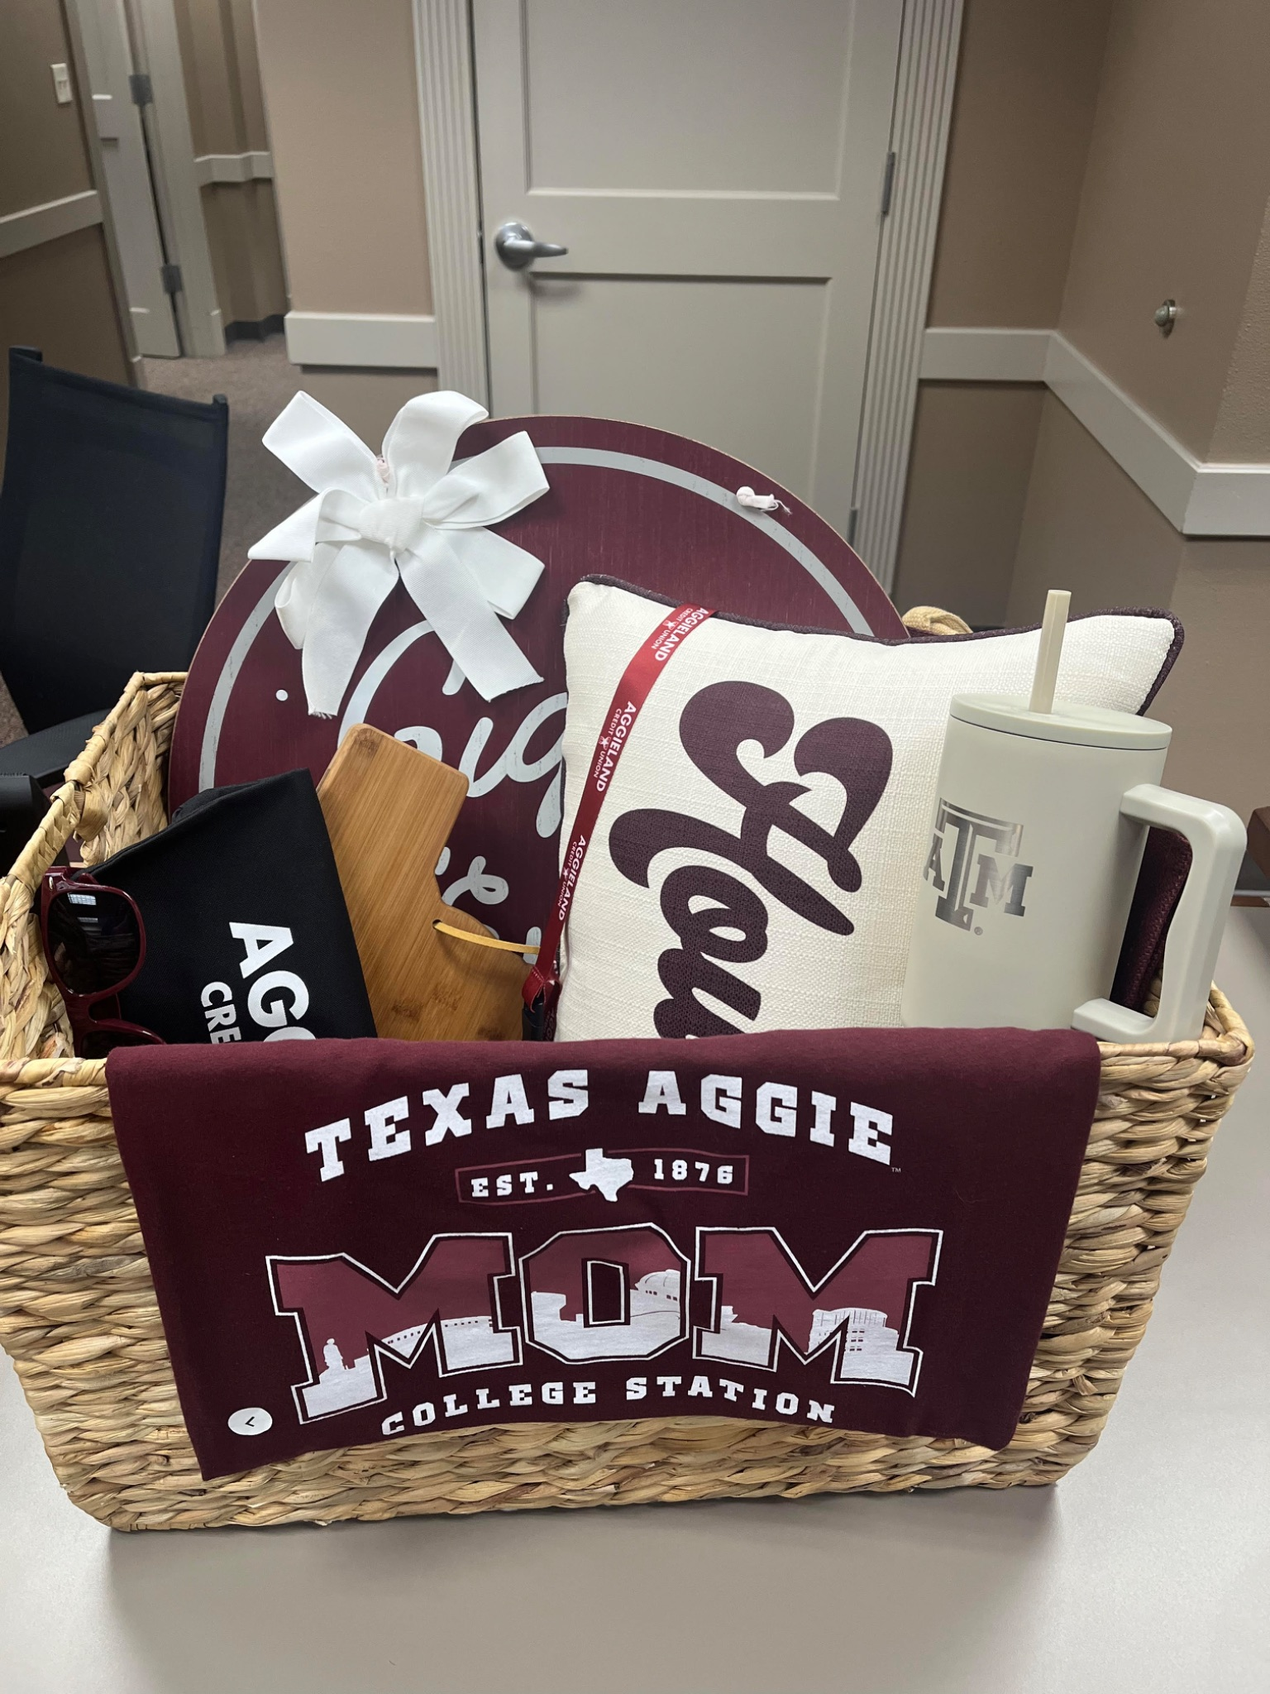
Development
Melanie Harrington
Development Officer
development@aggiemoms.org
Auction Baskets
Club Honor Roll
Become a Donor

Slide 30
Thank you for “Investing in Aggies”!

